Slide 1

Business Plan e-Health Service
By Nur Shazwani Aminuddin

Slide 2
Executive Summary
The active advancement of technology and communication system has increased users expectations and demands such as services that can enhance their information management and saves time with less complexity.
eHealth Care online registration and booking system takes advantage of the Internet's ability to organize and connect the fragmented healthcare services into a searchable database that is consumer-focused, and easy-to-use integrating QR code technology.
QR code technology is known to be fast and efficient thus, aimed to benefit both patients and healthcare professionals

Slide 3

About Us
eHealth Care is a general company business focused on delivering online services.
We offers application development for online registration and scheduling management using QR code technology for everyone regardless of age and demographic.
The patient management system in medical facilities is a significant importance due to its role in enhancing patient continuity of care. However, there are few problems and challenges faced

Slide 4

The Problems
Crowd
Time
Data Management
Complex Form

Slide 5

Management
Director
Sales Department
Marketing Department
Design Department
Programming Department

Slide 6
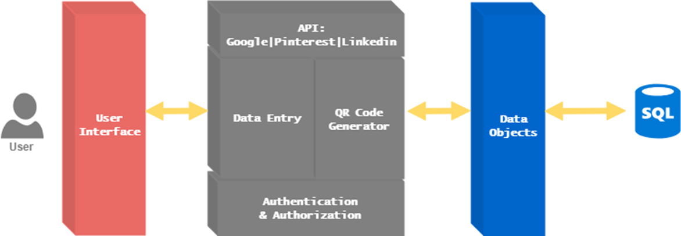
Architecture diagram

Slide 7
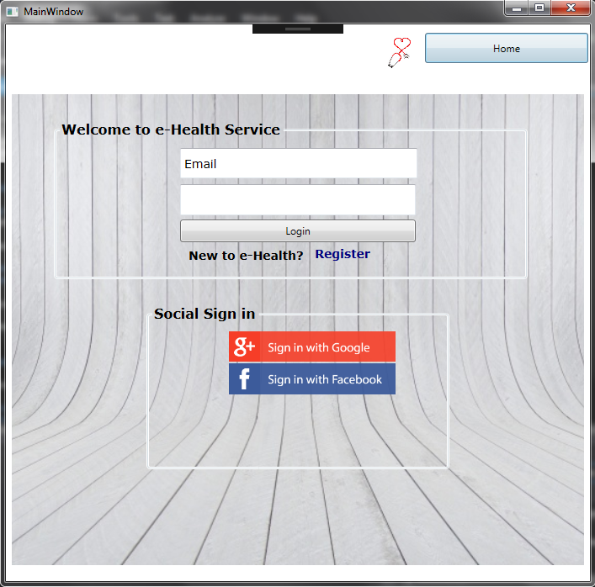
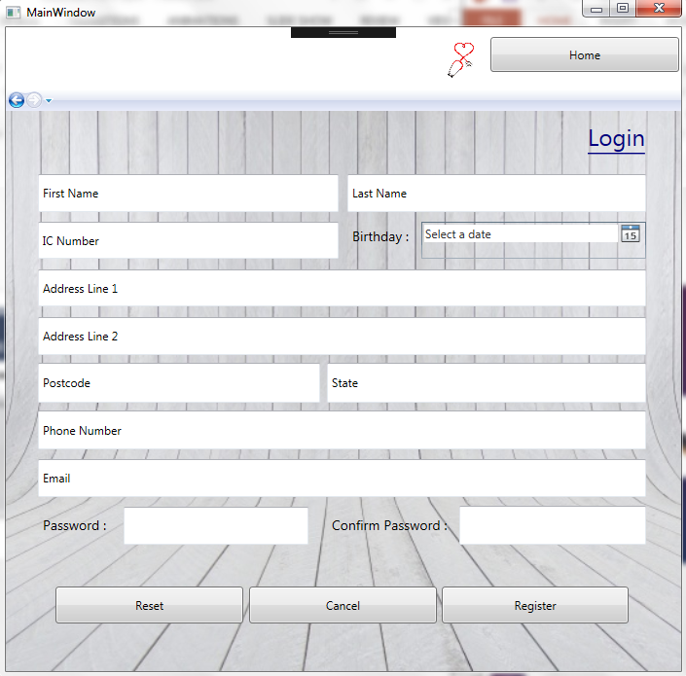
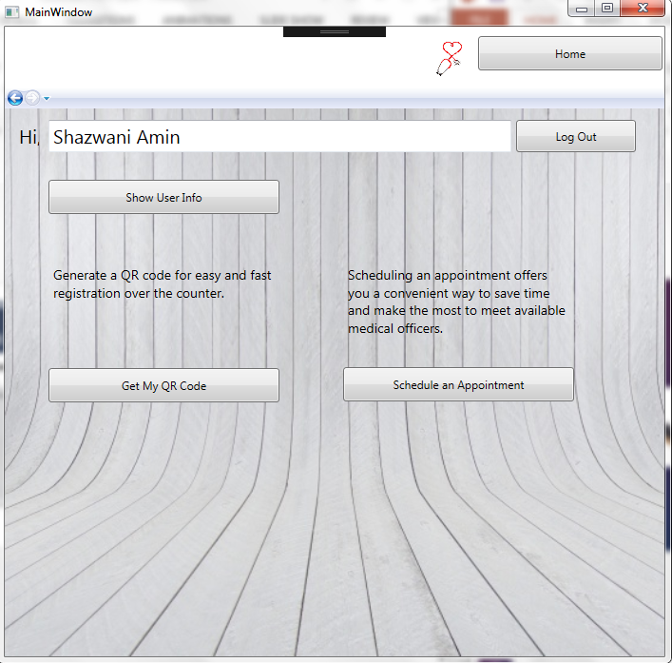
The application
Login window with multiple option based on social login or email registration
Registration page with basic credentials
e-Health portal with function to generate QR code and set an appointment

Slide 8
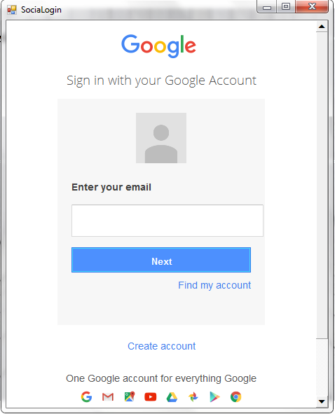
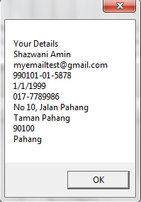
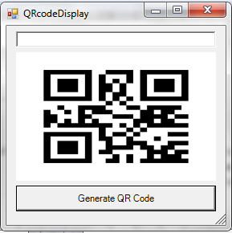
The application (cont.)
User details
QR code generate user unique profile
Social login option

Slide 9



Target Market
This application aimed to help individual and medical facilities to work efficiently and avoiding tedious task when handling large volume of patients data on daily basis.
Clinic
Individual
General Hospital

Slide 10
Growth Strategy
Customer Engagement
Customer Service and Support
Feature Optimization
Improve brand awareness amongst target market through promotions and marketing
Add support to users to track of customer queries and concerns.
Analytics to understand application usage data and keep measuring which features are drawing users.
Improve application quality by adding latest version of application.
Add unique features to improve awareness.

Slide 11
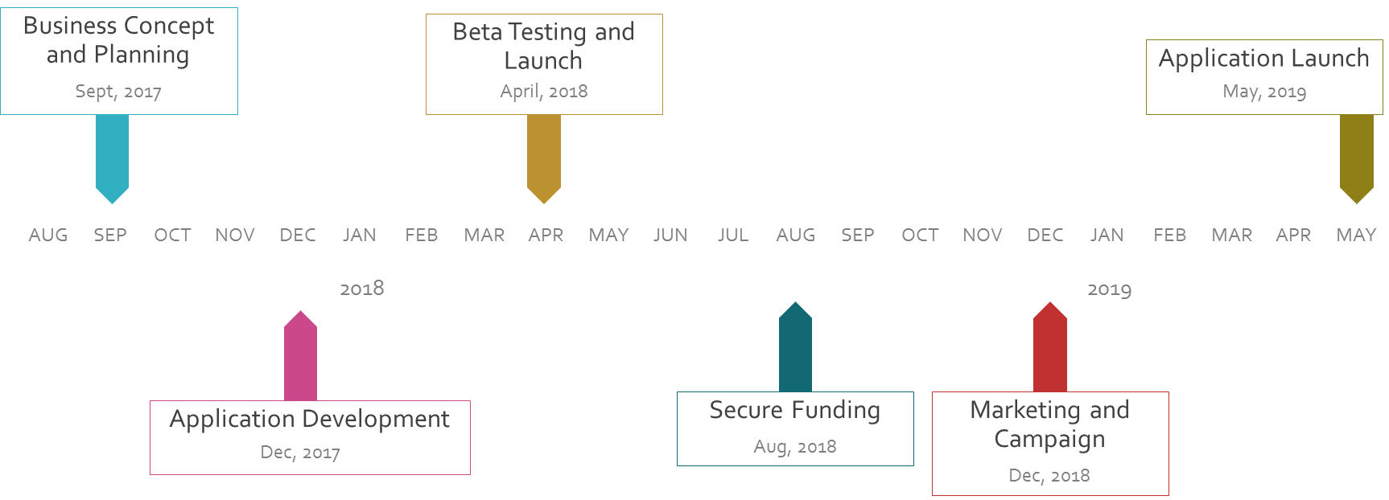
Timeline

Slide 12
Cost of development
Fixed Assets | MYR
Material | 55,000.00
System software and Cloud Engine Computer hardware Other | 25,000.00 15,000.00
Patent | 10,000
Total Implementation Costs | 120,000.00

Slide 13





Thank You
Nur Shazwani Aminuddin
+6017 7635342
wanieaminuddin@gmail.com
www.linkedin.com/in/nur-shazwani-aminuddin

